Slide 1



COVID-19
Data Analysis
Abdel Sini George (N01530574)
Femy Maria Jose(N01531559)
Goutham Prasad(N01531148)
Shilpa Annie John(N01531556)
Shruthy Chandran(N01530149)

Slide 2





Case
Introduction
During the past COVID-19 outbreak global agencies faced serious issues regarding the improper resource allocations. This led to increased fatality rates. This plight could have been avoided with optimal usage of resources.
In future, they can minimize the fatality rates by quickly identifying the hotspots based on real time analysis of COVID statistics and allocate resources accordingly.
Our project is to build a model to provide insights to minimize the consequences of the future outbreak.

Slide 3



Q
U
E
S
T
I
O
N
S
“How to estimate the total number of deaths in certain countries for which the total number of death is unknown ?”
“How to identify the COVID hotspots in different continents to facilitate the government decisions regarding:
Vaccination
Other emergency services”

Slide 4

Data Collection
The dataset we used is The complete Our World in Data COVID-19 dataset.
Link:
Coronavirus (COVID-19) Deaths - Our World in Data
It is a time series data of COVID global statistics and total number of deaths.

Slide 5


DATA
CLEANING
STEPS
Missing Values
Irrelevant and Incorrect Data

Slide 6



Irrelevant &
Incorrect Data
MISSING
VALUES
Other missing records
Based on skewness
Total Death
The irrelevant and incorrect records were identified and removed.
DEPENDENT VARIABLE
Impute with
Mean
NO IMPUTATION

Slide 7


DATA
ANALYTICS
MODELS
CHAID node
Neural Net
K-Means Clustering
Two-Steps Clustering

Slide 8
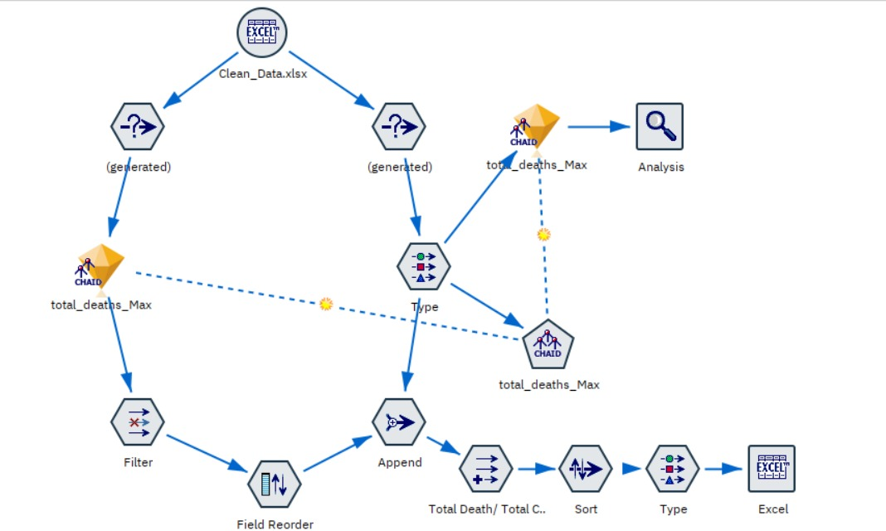
CHAID node
Select records with non null values for total death
Select records with null values for total death
Neural net model created using training data
Neural net model created using training data

Slide 9
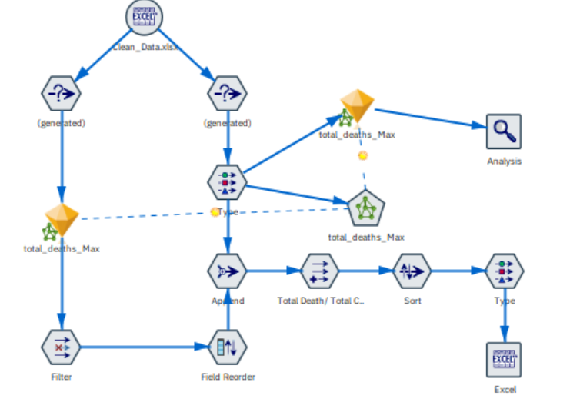
Neural Net
Select records with non null values for total death
Select records with null values for total death
Neural net model created using training data
Neural net model created using training data

Slide 10
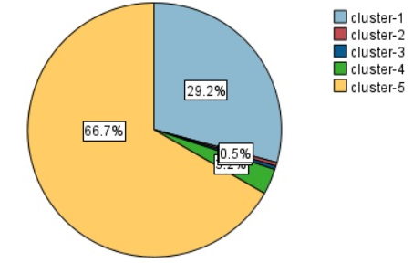
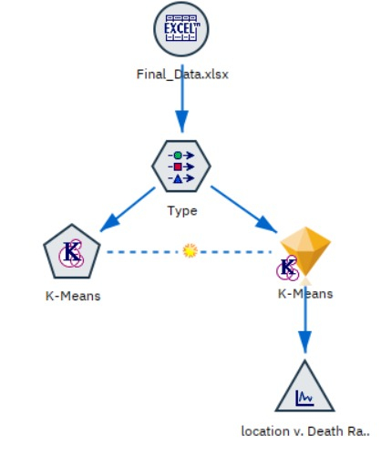
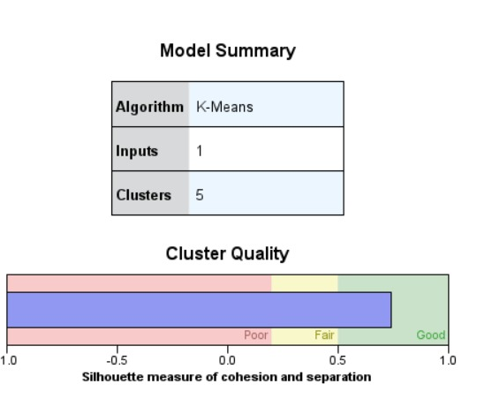
K-Means Clustering

Slide 11
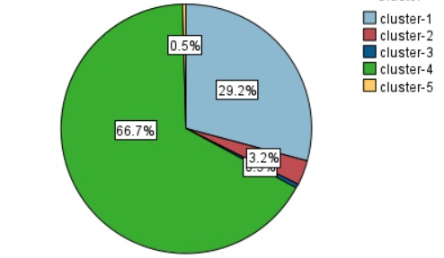
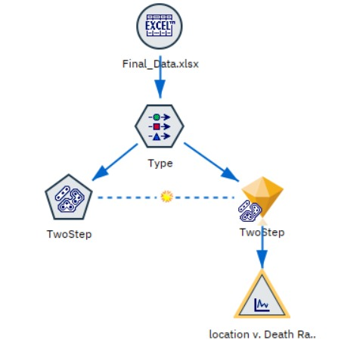
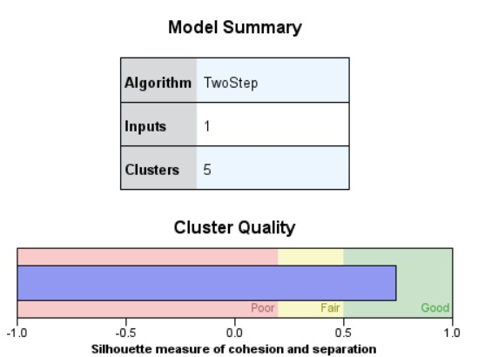
Two-Steps Clustering

Slide 12
Model COMPARISON
REGRESSION MODELS
CLUSTERING MODELS
K-Means Clustering
CHAID Model
Neural Net
Mean Absolute Error
14522.343
Mean Absolute Error
18240.759
Two-Step Clustering
Model conclusion:
CHAID model has the lower value of MAE
Hence it is the preferred model for the data set.
Model conclusion:
Both models give similar results on the dataset.
Hence anyone of the model can be used.

Slide 13
Conclusion
Cluster 5, Cluster 3, Cluster 2 are the clusters with significantly high values of total death/ total case ratio.
VATICAN
So, these countries should be prioritized and resource must be allocated accordingly.
Increase in
total death/total case ratio
Hence, these countries in the mentioned clusters are identified as the hotspots.
YEMEN
EGYPT
MEXICO
PERU
SOMALIA
SUDAN
SYRIA

Slide 14
References:
Mathieu, E., Ritchie, H., Rodés-Guirao, L., Appel, C., Giattino, C., Hasell, J., Macdonald, B., Dattani, S., Beltekian, D., Ortiz-Ospina, E., & Roser, M. (2020, March 5). Coronavirus (COVID-19) deaths. Our World in Data. https://ourworldindata.org/covid-deaths
Shih, D.-H., Shih, P.-L., Wu, T.-W., Li, C.-J., & Shih, M.-H. (2022, July 2). Cluster analysis of US covid-19 infected states for vaccine distribution. Healthcare (Basel,
Switzerland).https://www.ncbi.nlm.nih.gov/pmc/articles/PMC9323689/

Slide 15
T H A N K
Y O U

